Slide 1
Customer Churn
Noora Hussain Ali

Slide 2
Introduction
In this project, I explore customer churn. The main goal is to understand why some customers leave the company while others stay. By analyzing customer data. I hope to find the main factors that affect customer churn .

Slide 3
Problem Statement
The company is facing a high customer churn rate, where 55.52% of customers have left.

Slide 4
Objectives
Identify customer groups with higher churn rates.
Explore the key factors associated with customer churn.
Compare spending and service usage between churned and retained customers.
Analyze the relationship between support calls, payment delays, and churn.
Evaluate the impact of contract type on customer loyalty.

Slide 5
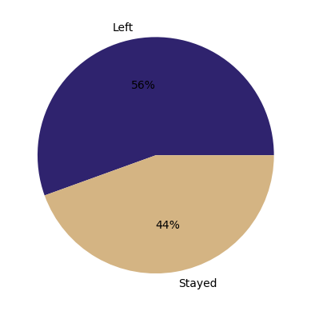
Churn Rate
The churn rate is pretty high at 56%, which means more than half left. We need to figure out why we are losing them.
The data shows that 56% of people left, while only 44% stayed. This is a clear sign that we need better ways to keep them

Slide 6
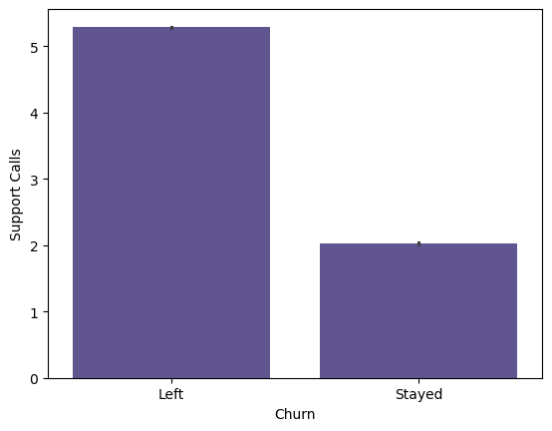
Support Calls vs Customer Churn
Churned customers made more than 5 support calls on average.
Loyal customers made around 2 support calls.
Frequent support requests indicate unresolved issues and lower customer satisfaction.
Recommendation: Automatically escalate cases after the 5th support call to reduce churn risk.

Slide 7
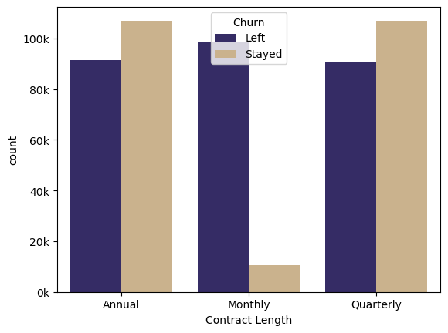
Churn by Contract Length
Monthly Contracts: Have the highest churn with almost everyone leaving
Annual Quarterly: Have more customers staying than leaving.
Conclusion: Monthly contracts are the main driver for customer churn.

Slide 8
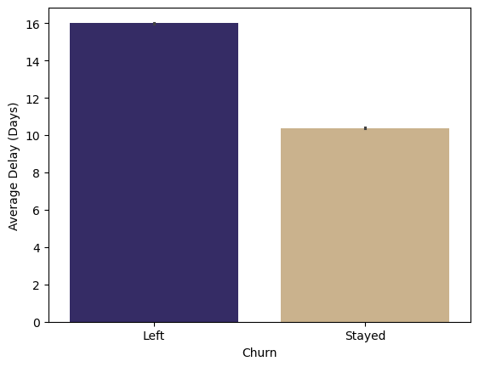
Distribution of Total Spend by Churn
Customers who left : High average payment delay of 16 days.
Customers who stayed : Lower average payment delay of 10 days.
Longer payment delays are strongly linked to higher customer churn.

Slide 9
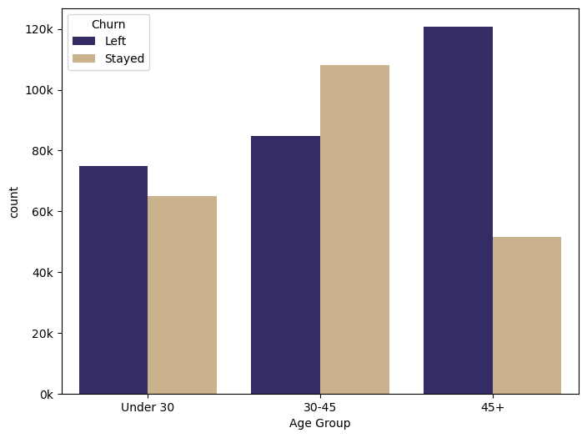
Churn by Age Group
High-Risk Segment: Customers in the "45+" age group show the highest churn rate, significantly exceeding those who stayed.
Stable Segment: Younger customers ("Under 30") appear more likely to stay, suggesting higher loyalty or different service needs.
Trend: As age increases, the tendency to leave the service rises, indicating that our retention strategies need to be more focused on older demographics.

Slide 10
Summary
Who leaves: Older customers (45+).
Best fix: Move customers to long-term (annual) plan
The limit: More than 5 support calls usually leads to churn.
Warning signs: Less service usage and payment delays (over 16 days).
Main reasons: Monthly contracts, too many support calls, and late payments.

Slide 11
Recommendations
Targeted Loyalty: Offer specialized support for the 45+ age
Proactive Support: Flag users after 5 support calls for urgent help.
Payment Reminders: Send alerts by day 10 to reduce payment delays. .
Boost Long-Term Contracts: Use discounts to switch monthly users to annual plans.

Slide 12
Thank you for your time and attention

